Slide 1

DEVELOP A FEEDBACK MANAGEMENT PORTAL FOR TRACKING CUSTOMER FEEDBACK
Team Members
Sakthivel R
Harivarsha P
Aishwarya M
Vikash B
College Name
SRM TRP Engineering
College

Slide 2
PROBLEM STATEMENT
Develop a feedback management portal for tracking customer
feedback
The task is to build an application that allows checking the customer
feedback and manage the portal for tracking customer feedback
The feedback platform collect feedback from various sources,
including social media, customer reviews, and surveys, and
convert the data into a structured format that can be easily analysed.

Slide 3
SOLUTION
Feedback Portal
The feedback platform collect feedback from various sources,
including social media, customer reviews, and surveys,and
convert the data into a structured format that can be easily analysed.
Collect Feedback
By creating a web applicaion which enables ways to
customers to submit feedback, such as a web form, email, or
social media channels.

Slide 4
SOLUTION
Categorize Feedback
Create categories or tags to help organize feedback and
identify common themes.
Prioritize Feedback
Prioritize feedback based on urgency, severity, or impact on
customer experience.it can be achieved by creating a scoring system based on
customer feedback frequency, sentiment analysis, and other metrics..

Slide 5
SOLUTION
Assign Feedback
Assign feedback to the relevant team member or department based
on the category and priority level.
Database
The database layer stores feedback and user information
It can be achieved by using MySql Database

Slide 6
SOLUTION
Admin Panel
A dashboard with an overview of feedback statistics, such as
the total number of feedback received, feedback status, and feedback
trends over time.
Report Generation
Generate reports on feedback trends and customer satisfaction
levels to identify areas for improvement
Communicate feedback results to relevant stakeholders, including
product owners, developers, and customer support teams.

Slide 7
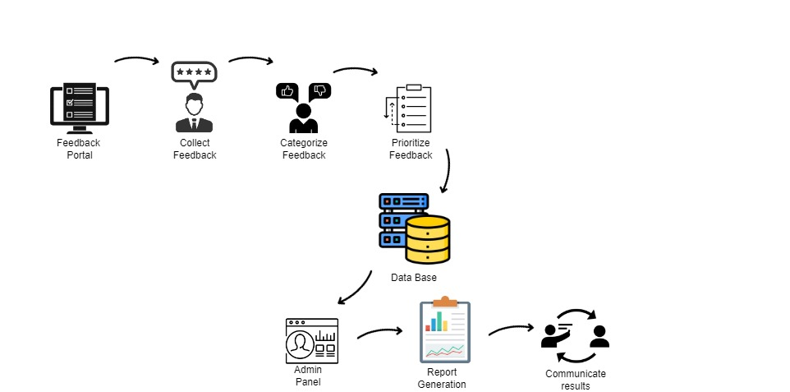
ARCHITECTURE

Slide 8
TECHNICAL STACK
HTML/CSS/JavaScript for the front-end
React for the front-end framework
Django and Node.js for the back-end
MySQL for the database
AWS for the hosting

Slide 9
ADVANTAGES
Improved Customer Satisfaction
Better Product Development
Increased Efficiency
Centralized Feedback Management
Data-Driven Decision Making

Slide 10

THANK YOU

